Slide 1
Mary Lyon Pilot High School
Guidance Night 2015
Thursday, October 8, 2015
6:00 – 7:00 PM

Slide 2
Agenda
Introductions
Overview
Advisory
Transition Planning
Your Plan For the Future ( YPFF)
New Programs
Question & Answers

Slide 3
Graduate Stats
Since 2013: 84 graduates
4 Year: 50 graduates
2 Year: 11 graduates
Military: 4 graduates
Alternative Options: 4 graduates

Slide 4
MLPHS Graduation Requirements
24 Credits
Course Distribution Requirements (Mass Core)
  ELA 4, Math 4, Science 3, Social Studies 3, Foreign Language 2, Fine Arts 1, Multimedia 1, Physical Education 1, Health 1, Electives 4
MCAS – ELA , Mathematics, and Science
40 Community Service Hours

Slide 5
Guidance Advisory 2015-2016
Objective:
To help students transition successfully through high school and gain a better understanding of who they are and how their individual needs, skills and characteristics play an important role in selecting post-secondary options.

Slide 6
9th
Study Skills
Time Management
Organization
Test Taking Skills
Learning Style
YPFF
4 Year Plan for High School
Community Service
Extra Curricular Activities
Avoiding Summer Learning Loss

Slide 7
10th
Graduation requirements
The PSAT
Creating a Resume
Identifying Career Interest
Exploring Values & Skills
Calculating GPA
Community Service
Professional Emailing
Summer Jobs & Opportunities

Slide 8
11th
4 –Year Plan
Identifying Post Secondary Options
College Entrance Requirements
The PSAT /SAT/ACT
Identifying Career Interest
College Search Resources
Introduction to Financial Aid
Perfecting Resume/ Interview Skills
Brainstorming College Essay

Slide 9
12th
Review 4 Year Plan
Post Secondary Planning
College Application Process
Common App
Financial Aid
Scholarships
GAP Programs/Military
Transitioning to Life After High School
Interviewing and Networking Skills

Slide 10
Additional Topics
Proper Use of Social Media
Financial Literacy: Banking/Saving
Job Search
Completing Applications
Proper Business Attire
Public Speaking

Slide 11

Guidance Counselor
SAT Prep
SAT/ACT
Working Papers
Schedules, Community Service
Fee Waivers, Your Plan for the Future, Work Study , Transition Planning, IEP /Parent Meetings
Transition Plans, FAFSA/CSS Profile,
Monitor Deadlines, Support students in applications
Parent/Guardians
Roles & Responsibilities
Leading Advisory
Classroom Management
Your Plan for the Future
Recommendations
Taking attendance
College Applications
Financial Aid
Scholarships
Campus Tours & College Rep Visits
College Advisor
Teacher Advisor

Slide 12
Parent Role
Help students set realistic goals for the year
Review and sign Transition Plan
Encourage your child to be involved in extracurricular activities. Show your support by attending events.
Help your child explore and evaluate a variety of career and educational options.
Help your child stay organized
Communicate with school often (Teachers, Advisor, Guidance office)

Slide 13
Post-Secondary Planning
The purpose is to facilitate successful transition from high school to the next phase of young adulthood.
Each student will develop a 4 year transition plan with advisor and guidance.
Develop concrete actions steps to help guide and prepare students for college and/or career and /or independent living skills
Review and update yearly as needed

Slide 14
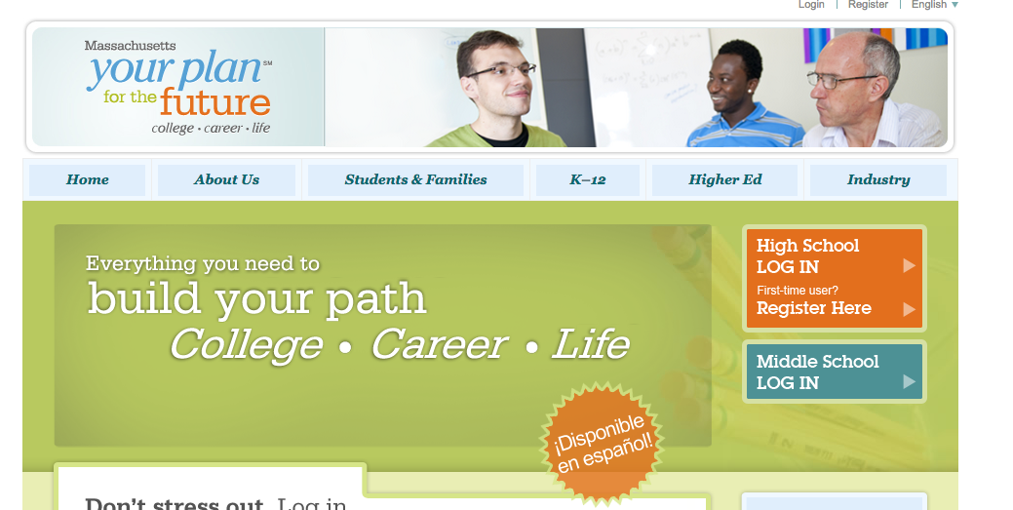
Your Plan For the Future

Slide 15
Upcoming Events …
Career Day
College Fairs
  BPS October 17th
  NACAC in Spring
College Month - October
College Tours
College Visit Day 10/14
10 & 11th PSAT
College Reps Visits
Bi Weekly Guidance Newsletter
Decision Day Celebration
Alumni Spirit Days
PIC Job Shadow Day

Slide 16
Questions/Suggestions
?

